Slide 1
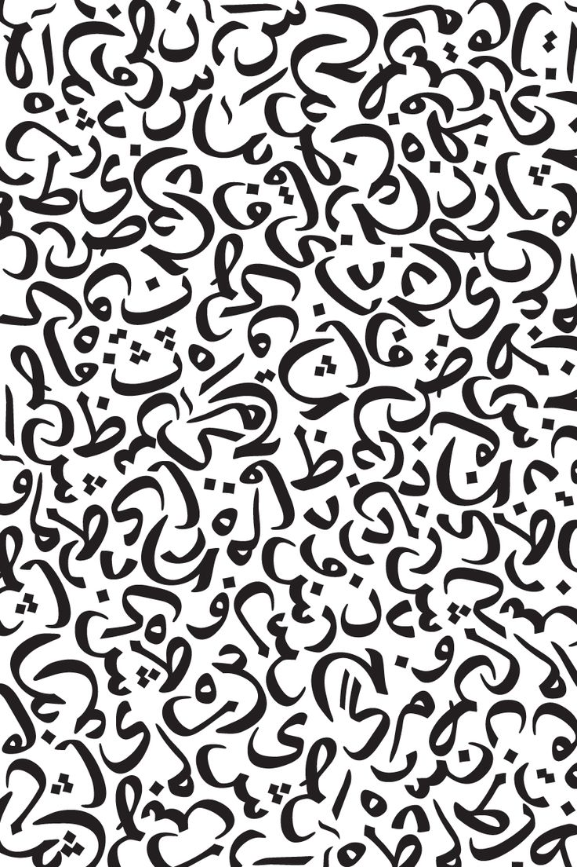

LAHGA
An Arabic Language Dialect Identification System

Slide 2
Group Information
Members:
Mohamed Hamza
Nesma Badr
Karim Atwa
Ziad Abdel Ghany
Supervised by:
Dr. Mohamed Moustafa

Slide 3
Outline
Introduction
Approach
System Overview
Applications
Challenges
Demo

Slide 4

Introduction

Slide 5
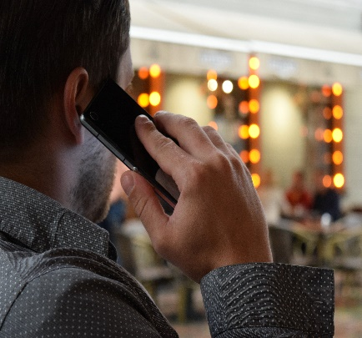

Motivation
Arab to Arab Communication
Speech Recognition & Translation

Slide 6
Thesis Statement
Our goal is to develop a neural network that would classify different spoken Arabic dialects using deep learning.

Slide 7
Approach

Slide 8
Approach
Data Collection
Spectrogram Conversion
Neural Network
App Integration

Slide 9
Data Collection
Sources
Youtube Videos
Recorded Speech
Other datasets
Audio Processing
Audio Segmentation

Slide 10
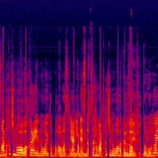
Spectrogram
What is a Spectrogram
Why Spectrograms

Slide 11
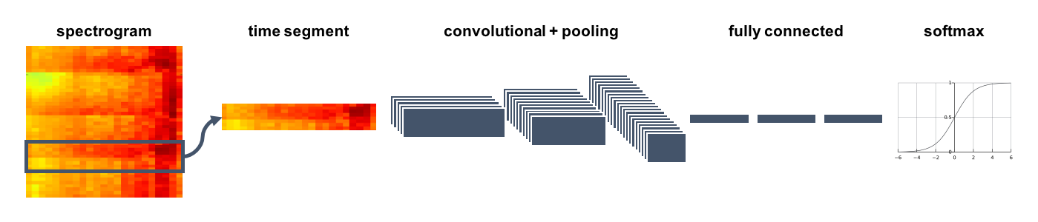
Neural Network
Spectrogram Time Segment Feature Extraction Classification Prediction

Slide 12
Integration
Neural Network Model optimization
Building ffmpeg binaries
Build TensorFlow interface
CPU architectures supported: ARMV7 & ARM64-V8A & X86
Supported API levels: 24+ (Nougat 7.0)
Notes:
Building ffmpeg binaries for android and creating a dynamic library wrapping of ffmpeg functionality using Android NDK.
Build TensorFlow interface by building the tensorflow native call using Bazel and Android NDK.

Slide 13
System Overview

Slide 14
Features
Supported Dialects
History
Stand-alone application
Noise Suppression
Prediction Average

Slide 15
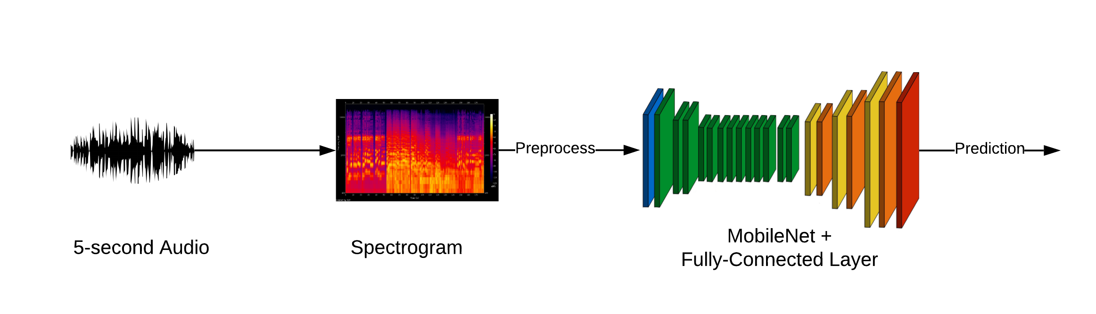
Prediction Process

Slide 16
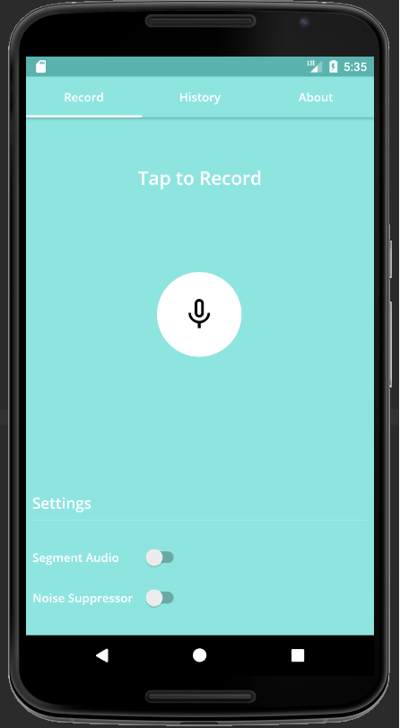
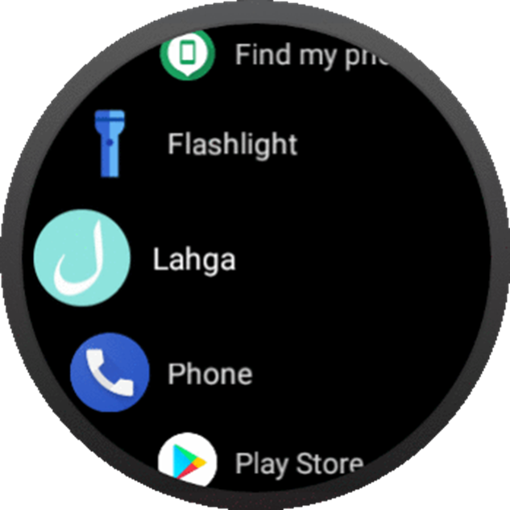
Platforms
Android Phone
Android Wear

Slide 17
Applications & Challenges

Slide 18
Applications
Speech Recognition and Translation
Voice Communication Applications
Region-based Advertisements
Movie and music suggestion

Slide 19
Challenges
Data
Multiple Variables
Common Arabic phonetics
Small Audio Segment
Integration

Slide 20
Demo

Slide 21


